Slide 1
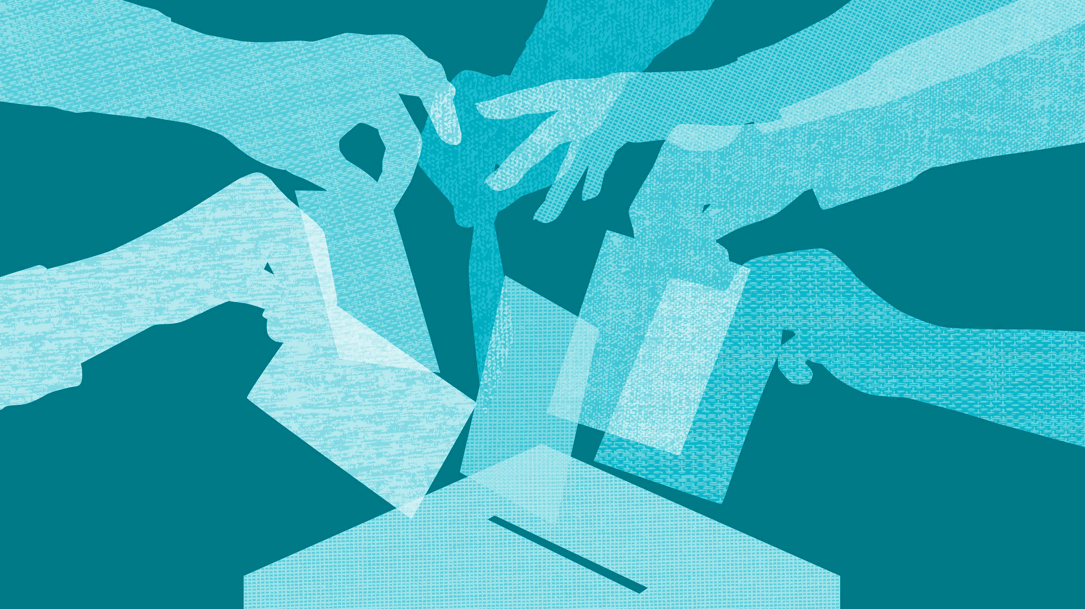

Digital Democracy:
Needfinding II + Ideation
Team Generation-G
Garrick F. | Gen S. | Grace W.

Slide 2
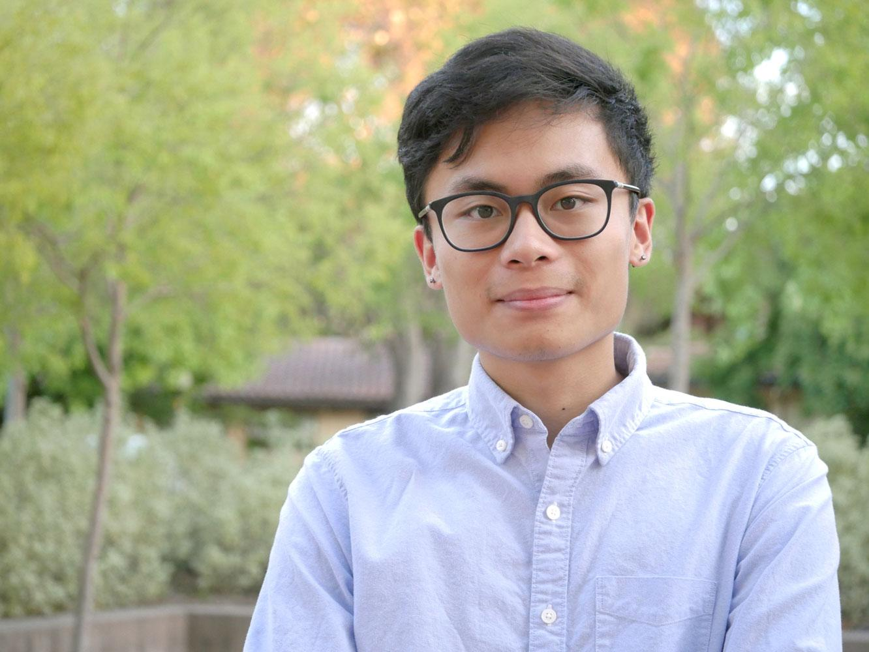
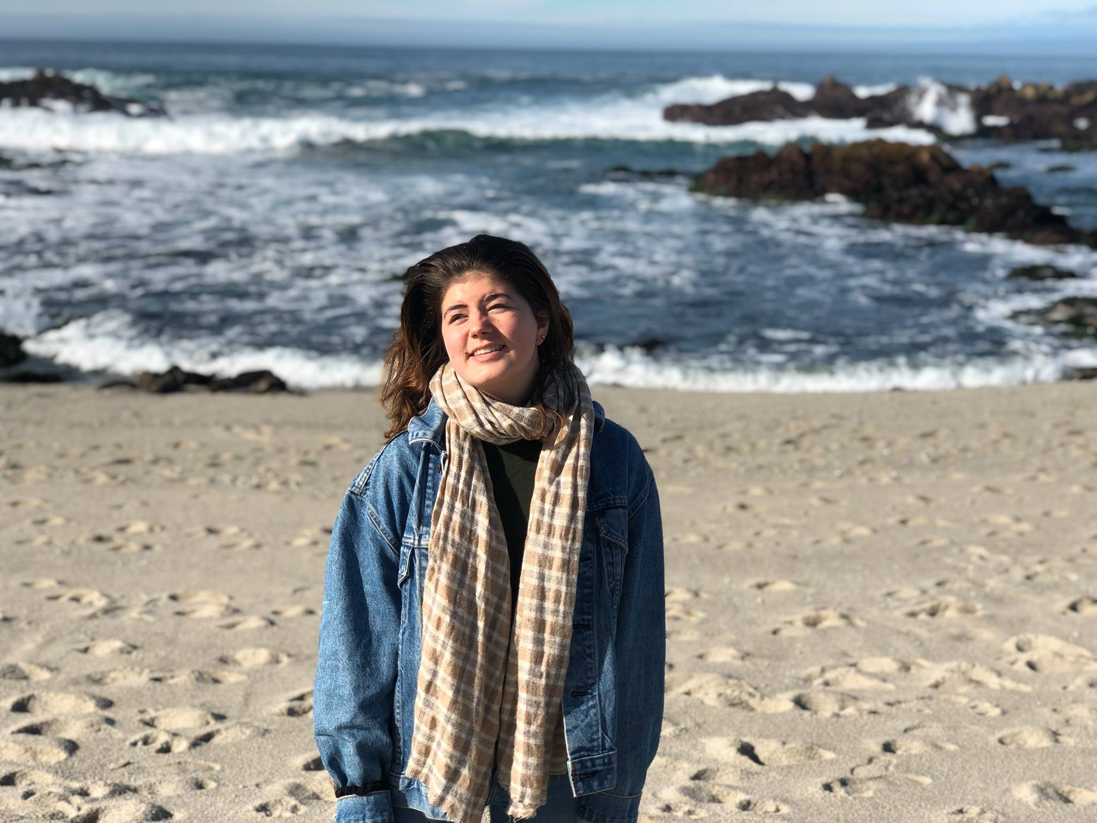
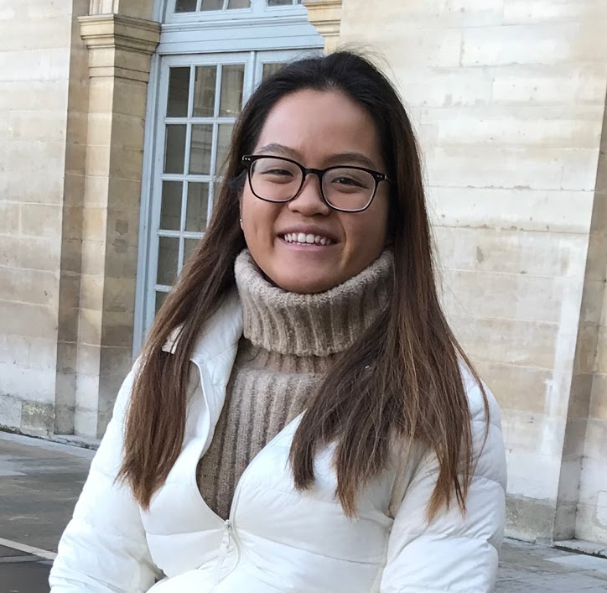
Garrick
Gen
Grace
Coterm, CompSci
only looking for trouble
Senior, SymSys
audible from a mile away
Senior, Econ
hates hard-boiled eggs
Problem Domain
Our problem domain is focusing on improving online political discourse and information sharing.

Slide 3
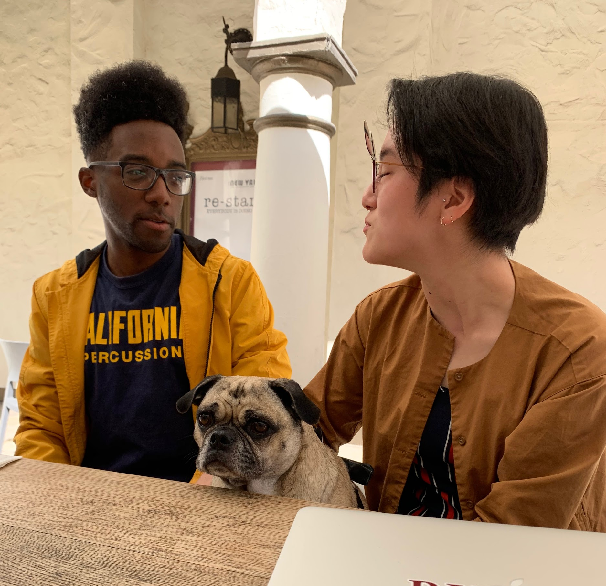
Initial POV
We met S, a recent Berkeley graduate and volunteer at a free health clinic.
We were surprised to find that in political discussions, he enjoys playing devil’s advocate but does not often change his mind.
It would be game-changing to enable him to participate in more well-rounded discussions with others.

Slide 4
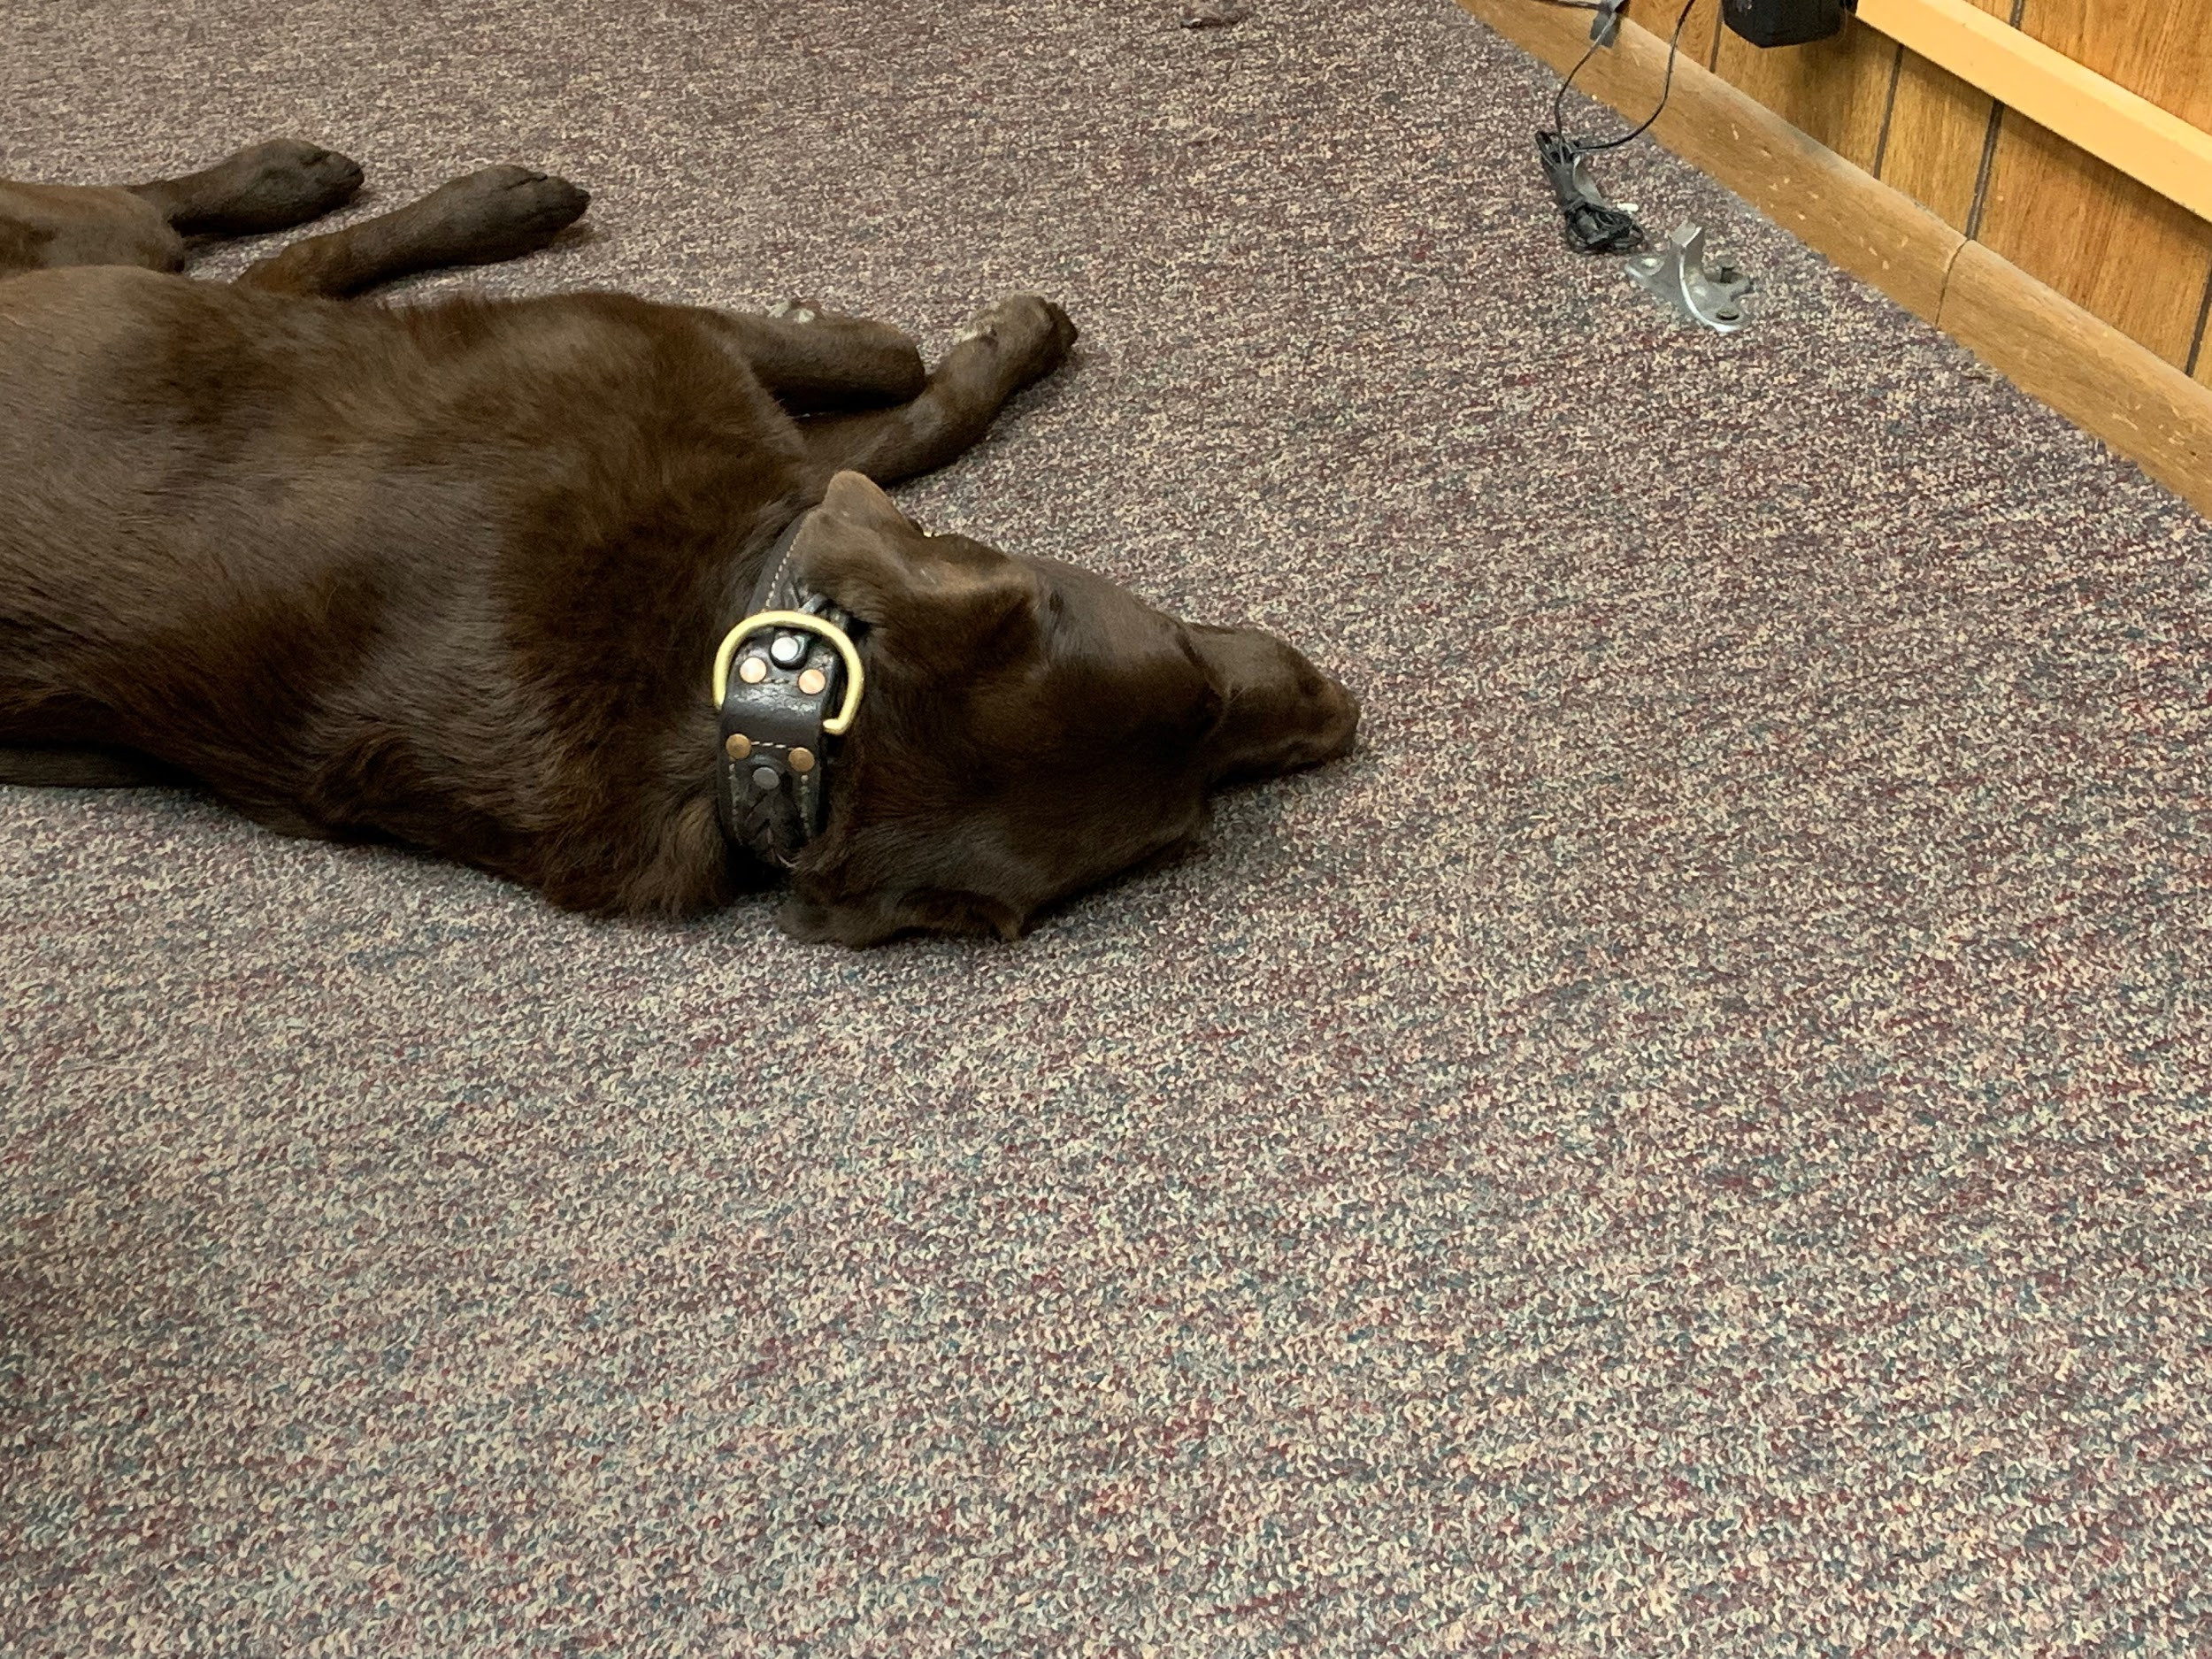
Needfinding II
Goal: with focused insights, broaden audience
S
K
M
I
A
D
L
C
J
🐶
Last Week:
4 people
2 M | 2 F (& 1 dog)
21-29
This Week:
5 people & less letters to choose from
3 M | 2 F
17-69

Slide 5
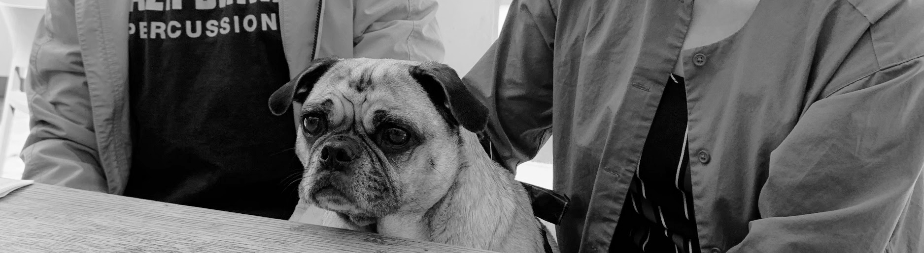
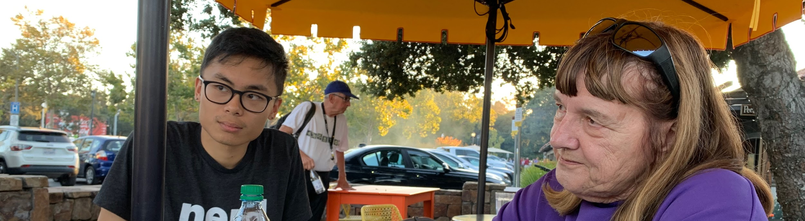
Needfinding II
Goal: with focused insights, broaden audience
Last Week:
- Consuming news
- Voting behaviors
- Political involvement
- Discussing the news
This Week:
- Issue of political discourse
- Communities and sharing
information within them
- Online/offline convos
Notes:
Say something about how we went into new interviews with ideated POV’s and, instead of a discussion guide with explicit questions, some focus areas or touchpoints. Less contextual interviews this time around.

Slide 6
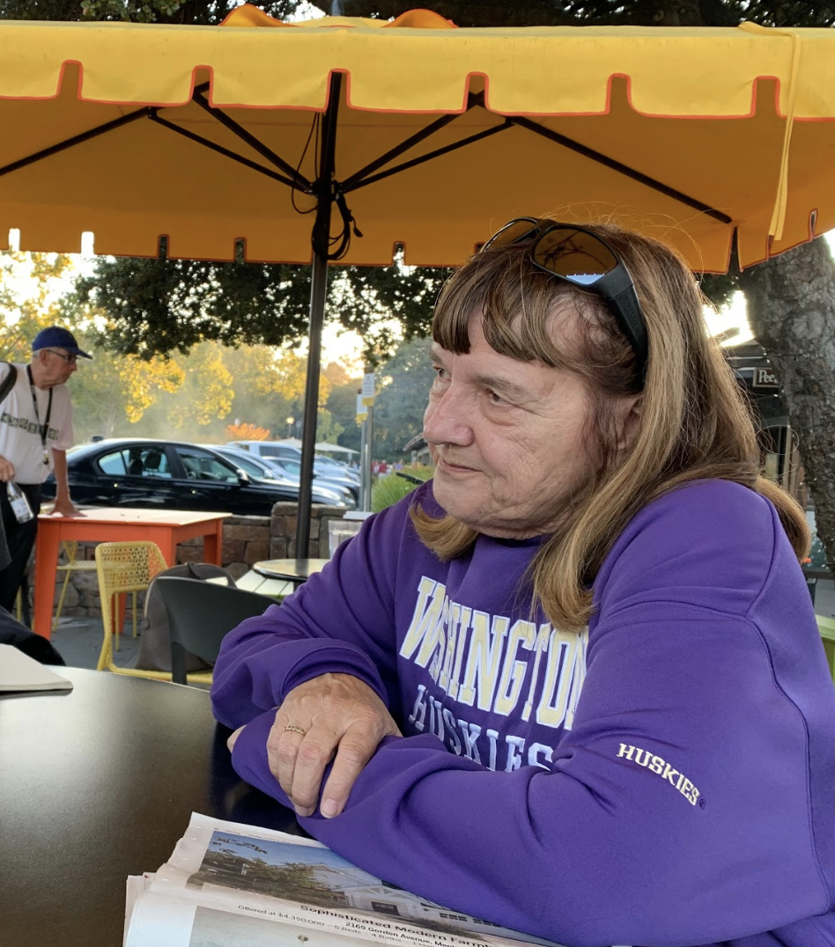
L, a Polish
grandmother
from Southern
California
Initially rejected her mixed-race grandchildren until she “held [her first grandchild] in my arms.”
Disowned by her extended family; sends annual Christmas cards to them.
Notes:
For the last 20 years, she has sent an annual Christmas card to her family with updates on her grandchildren; however, these cards have gone unanswered.

Slide 7
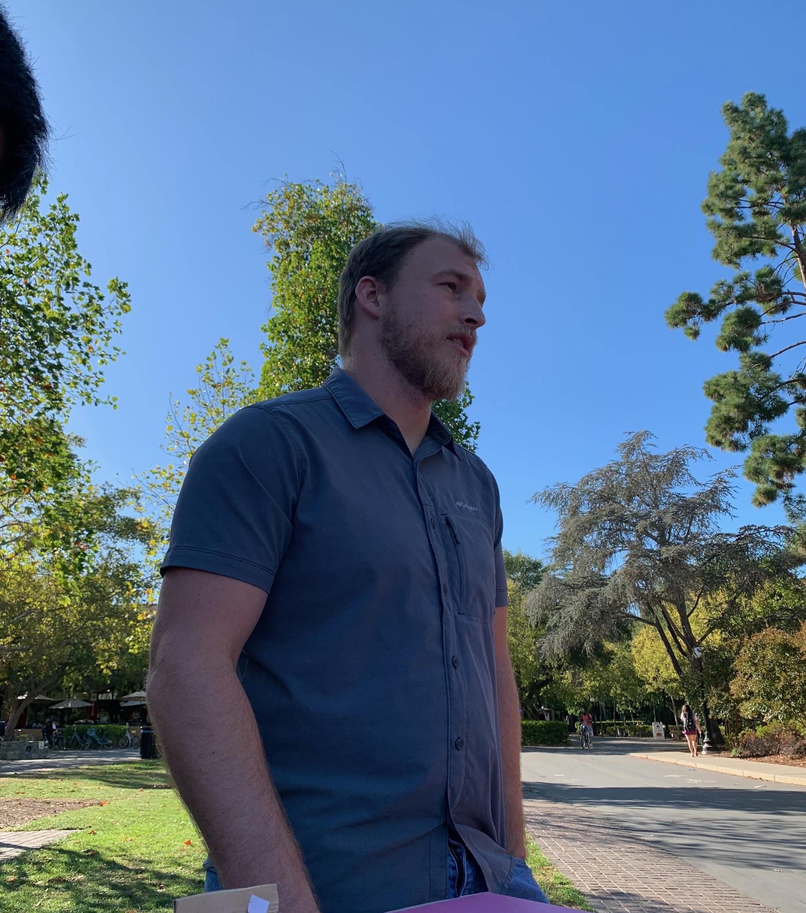
D, a Democratic Socialist and veteran from the Bay Area
Became interested in Marxist and anarchist ideas in the military.
Dislikes the “one-up” culture of online forums like Reddit.

Slide 8
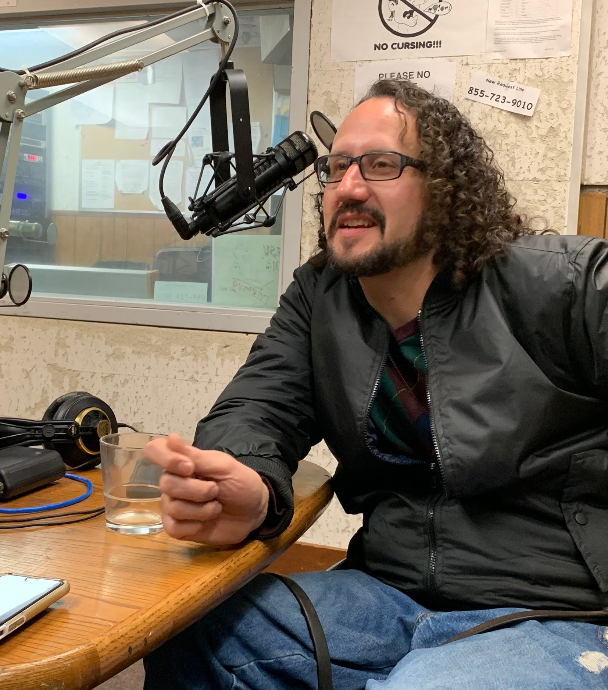
A, a radio show host and math Ph.D. candidate from Northern California
Considers issues from different perspectives; reads books to inform self.
Uses Facebook primarily as a personal memory bank, instead of an ad platform (for consumption goods).

Slide 9
“
A on using social media:
Well, I try to do positive things and have an honest perspective that might actually help people instead of just trying to like, post just happy things to make your life look great. I think that's hurting us more than helping us. I'm probably not your average social media user...I use it more as like what it's actually is, which is an advertising platform for happy and uplifting things.
”

Slide 10
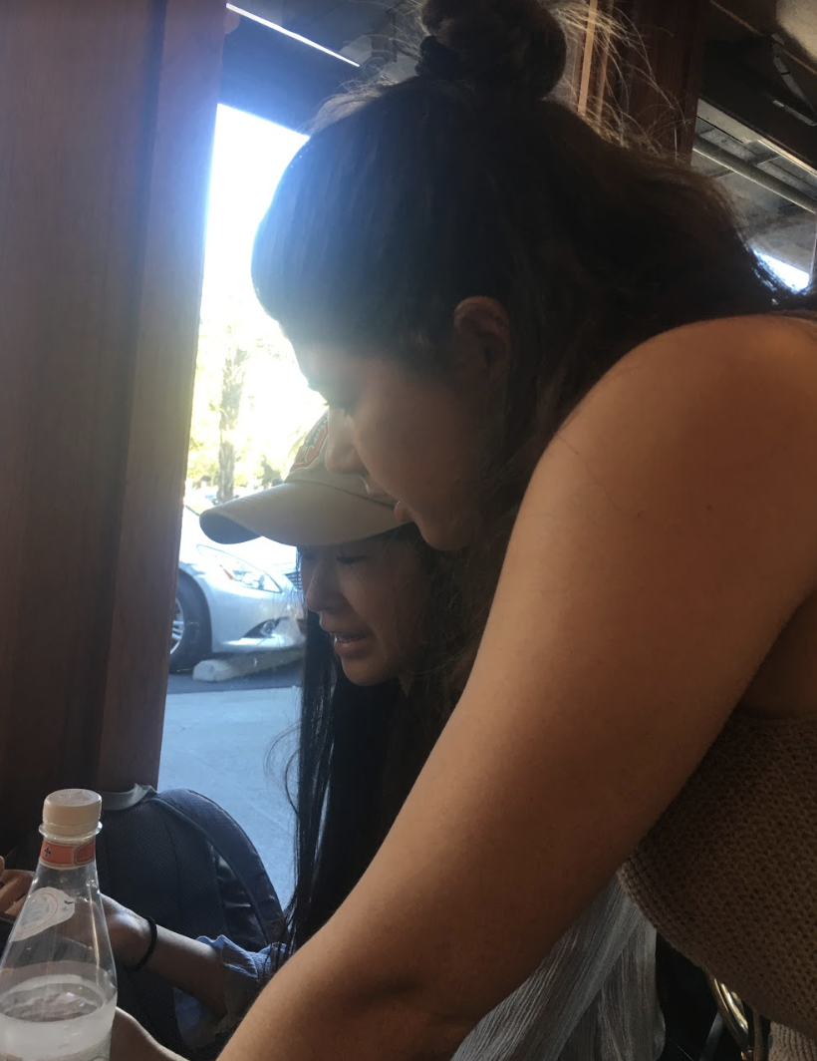
C, a tennis shop employee from Hungary:
did not feel knowledgeable enough to talk to us about digital democracy; believes keeping up with the news is “not healthy” for him.
J, 17 year old freshman at Stanford from Oregon: stopped listening to NPR / reading the newspaper since Stanford.

Slide 11
Point of View #1
We met D, a Democratic Socialist and veteran from the Bay Area.
We were surprised to realize that he stopped engaging on Reddit once he was proven wrong or “one-upped” in an online argument.
It would be game-changing to remove personal stakes from online political engagement.

Slide 12
Point of View #1
We met D, a Democratic Socialist and veteran from the Bay Area.
We were surprised to realize that he stopped engaging on Reddit once he was proven wrong or “one-upped” in an online argument.
It would be game-changing to remove personal stakes from online political engagement.
HMW situate political debates in a human context?
HMW make political debates fun and not stressful?
HMW give gentler online feedback?

Slide 13
Point of View #2
We met L, a grandmother and nurse from Southern California.
We were surprised to realize that she sends letters each year to her estranged family to try and change their minds on race, particularly around her mixed-race grandchildren.
It would be game-changing to bridge the gap between her old family and her new one.

Slide 14
Point of View #2
We met L, a grandmother and nurse from Southern California.
We were surprised to realize that she sends letters each year to her estranged family to try and change their minds on race, particularly around her mixed-race grandchildren.
It would be game-changing to bridge the gap between her old family and her new one.
HMW remove insularity from homogeneous communities?
HMW create new traditions to build gaps between family?
HMW connect politics and humanity in high stakes environment?

Slide 15
Point of View #3
We met K, a student moving from Tacoma to the Bay Area.
We were surprised to realize that she feels guilt from going from actively participating in activist circles in Tacoma to just “keeping up” with the news in California.
It would be game-changing to help her realize the community that she wants.

Slide 16
Point of View #3
We met K, a student moving from Tacoma to the Bay Area.
We were surprised to realize that she feels guilt from going from actively participating in activist circles in Tacoma to just “keeping up” with the news in California.
It would be game-changing to help her realize the community that she wants.
HMW remove feelings of guilt over one’s level of engagement?
HMW make keeping up with news like Netflix?
HMW bridge communities across space?

Slide 17

Top 3 HMW’s
HMW situate political debates in a human context? (D’s POV)
Solution #1: Enable users to hold a political conversation with people who are geographically close by.
HMW remove insularity from homogeneous communities? (L’s POV)
Solution #2: Create intelligently-matched groups of people that have (1) similar levels of engagement and (2) different political views.
HMW remove feelings of guilt over one’s level of engagement? (K’s POV)
Solution #3: Celebrate small acts of political engagement.

Slide 18
Top 3 HMW’s
HMW situate political debates in a human context? (D’s POV)
Solution #1: Enable users to hold a political conversation with people who are geographically close by.
HMW remove insularity from homogeneous communities? (L’s POV)
Solution #2: Create intelligently-matched groups of people that have (1) similar levels of engagement and (2) different political views.
HMW remove feelings of guilt over one’s level of engagement? (K’s POV)
Solution #3: Celebrate small acts of political engagement.

Slide 19
Experience Prototypes

Slide 20
Experience Prototype #1: Map
HMW situate political debates in a human context?
Solution #1: Enable users to hold a political conversation with people who are close by.
Assumption: knowing you are close-by to others who are willing to talk about politics reduces the activation energy of reaching out.

Slide 21
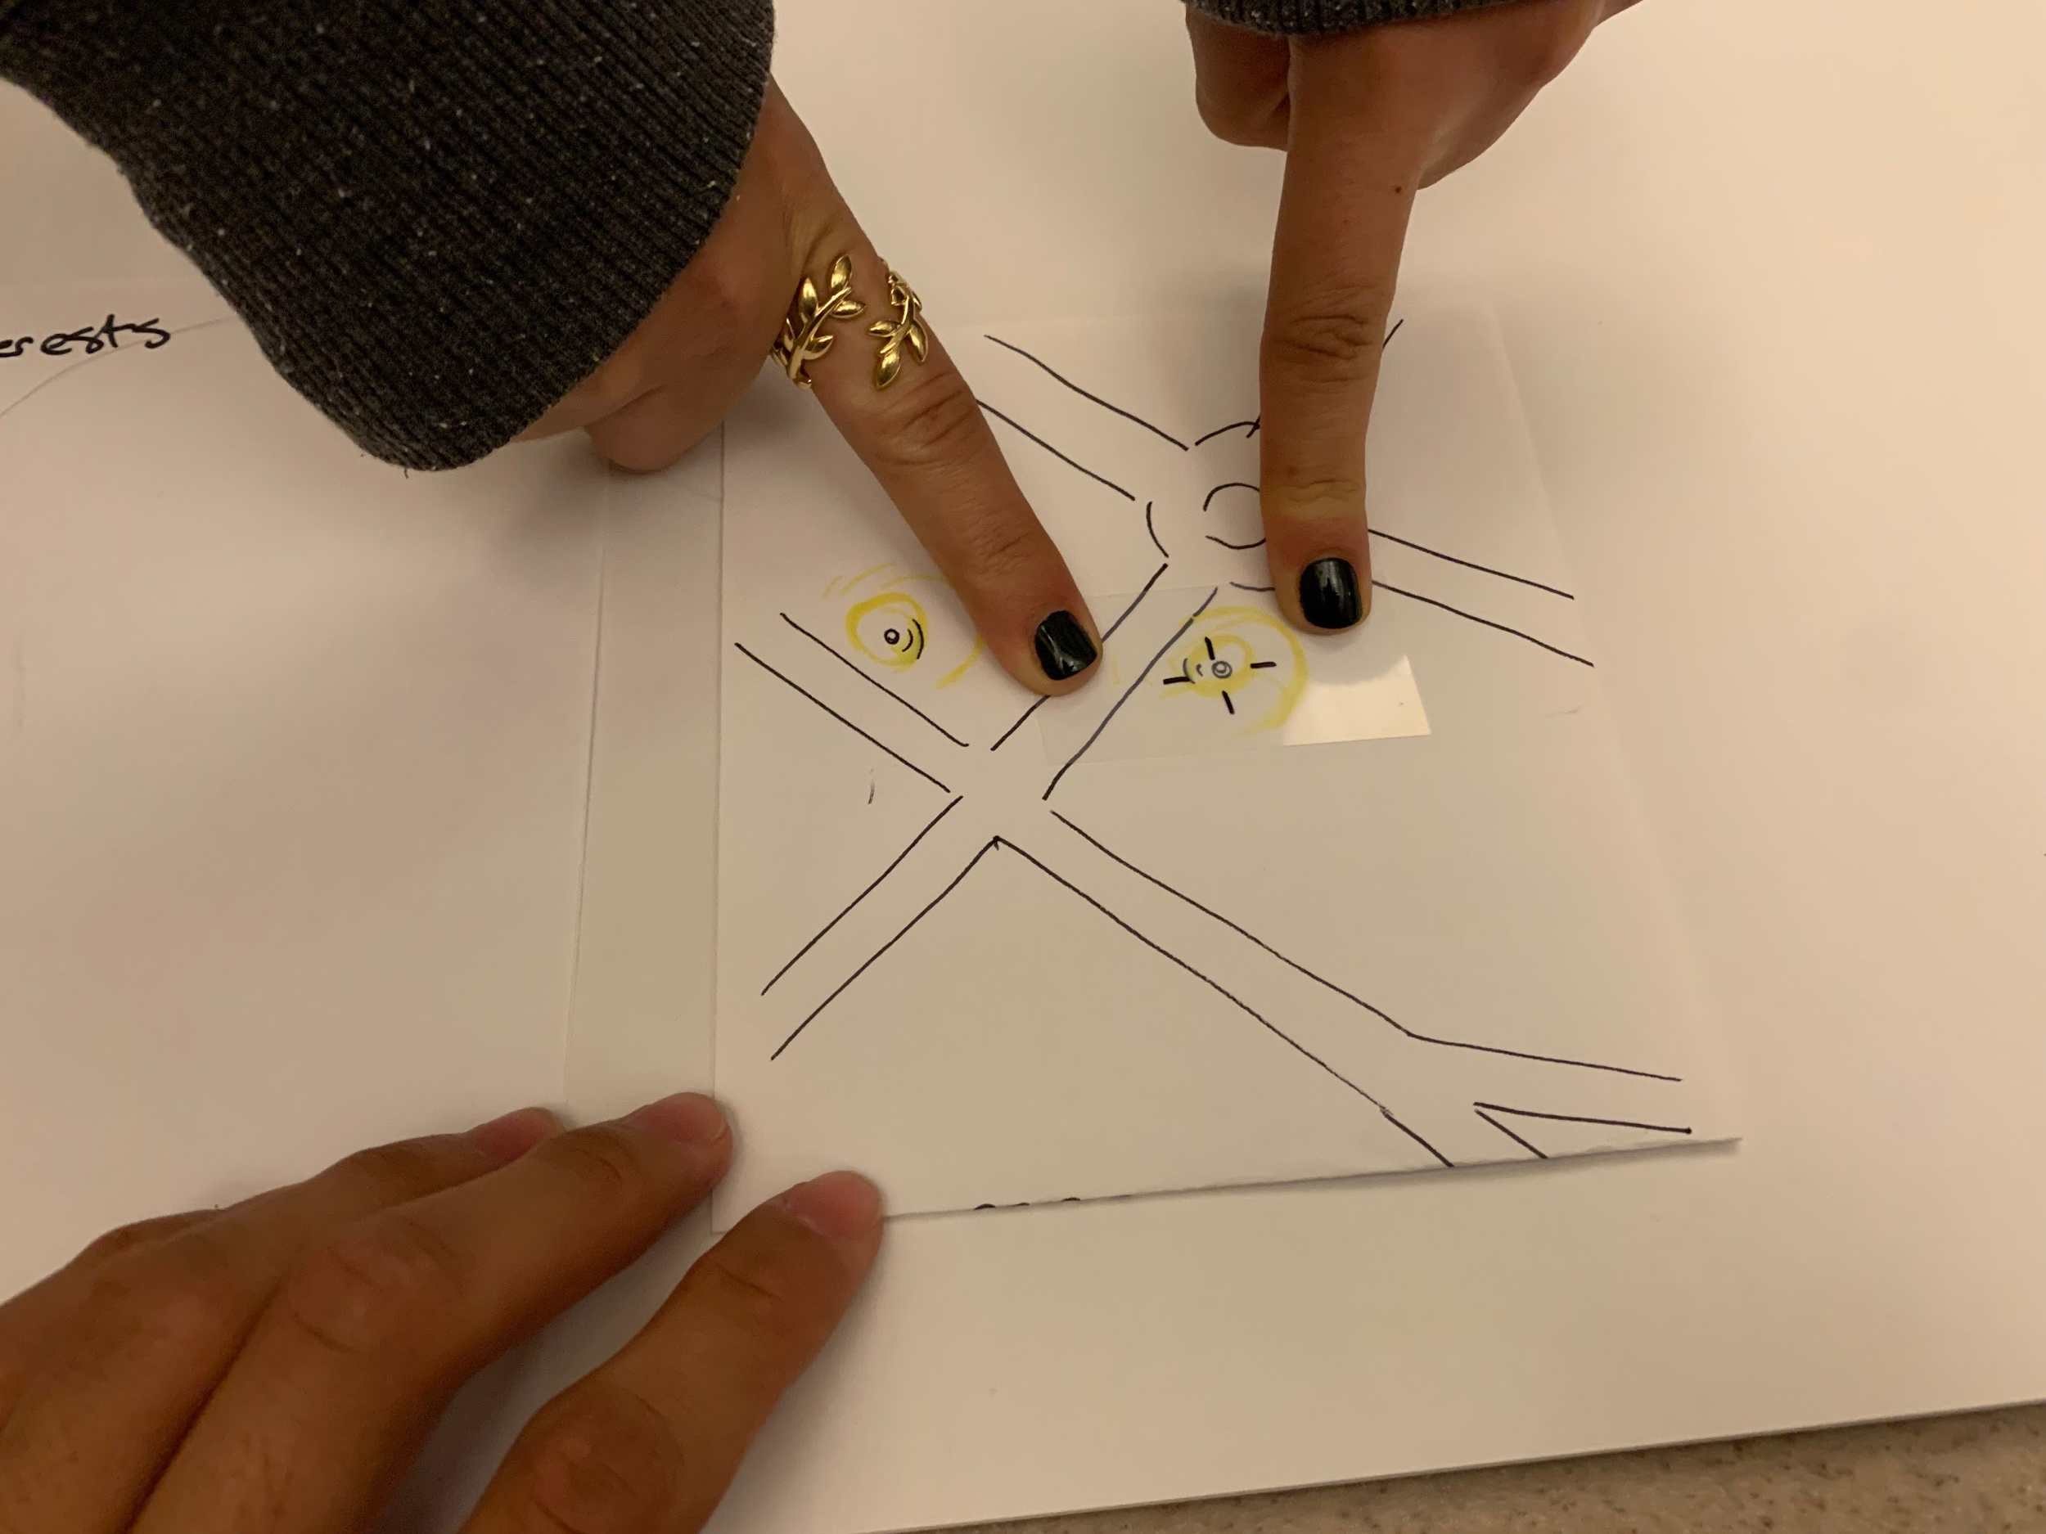
Experience Prototype #1: Map
Method:
Result:
3 participants
Users weren’t necessarily willing to meet the people (assumption wrong), but willing to consider
People would prefer lower-energy and safer features: IRL conversations are taxing
Hidden assumption: face-to-face dialogue should be encouraged.

Slide 22

“If I wanted to have an argument, I’d go on Twitter.”
“Yikes moments IRL are 10x worse.”
“I’m worried about my information- are [the nearby people] screened?”
“Would’ve preferred a chatroom.”

Slide 23
Experience Prototype #2: Conversation
HMW remove insularity from homogenous communities?
Solution #2: Create intelligently-matched groups of people that have (1) similar levels of engagement and (2) different perspectives or political affiliations.
Assumption: people want to engage with different perspectives on political issues that they are interested in.

Slide 24
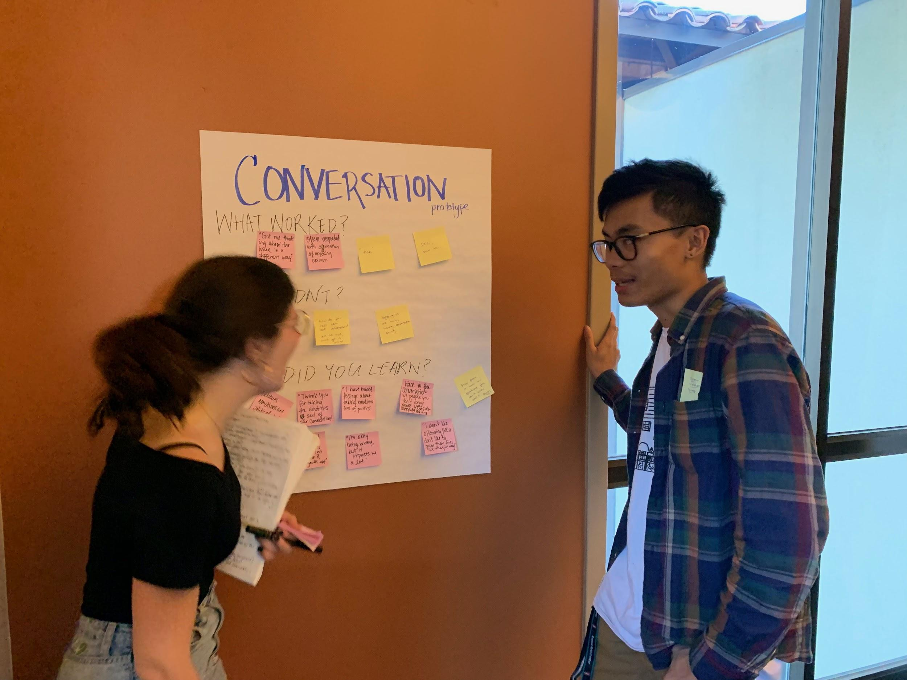
Experience Prototype #2: Conversation
Method:
Results:
4 participants
Neutral to positive feedback
Didn’t provide anything beyond what one could already get on the Internet
Assumption neither validated nor invalidated; participants seemed open and willing to engage with differing perspectives, but also didn’t see great value in having these conversations.

Slide 25

“This got me thinking about the issue in a different way.”
“I don’t like offending folks...don’t like to make them feel like they’re wrong”

Slide 26
Experience Prototype #3: Slider
HMW remove feelings of guilt over one’s level of engagement?
Solution #3: Celebrate small acts of political engagement.
Assumption: recognizing and validating small acts of political engagement makes people feel happier with their level of engagement.

Slide 27
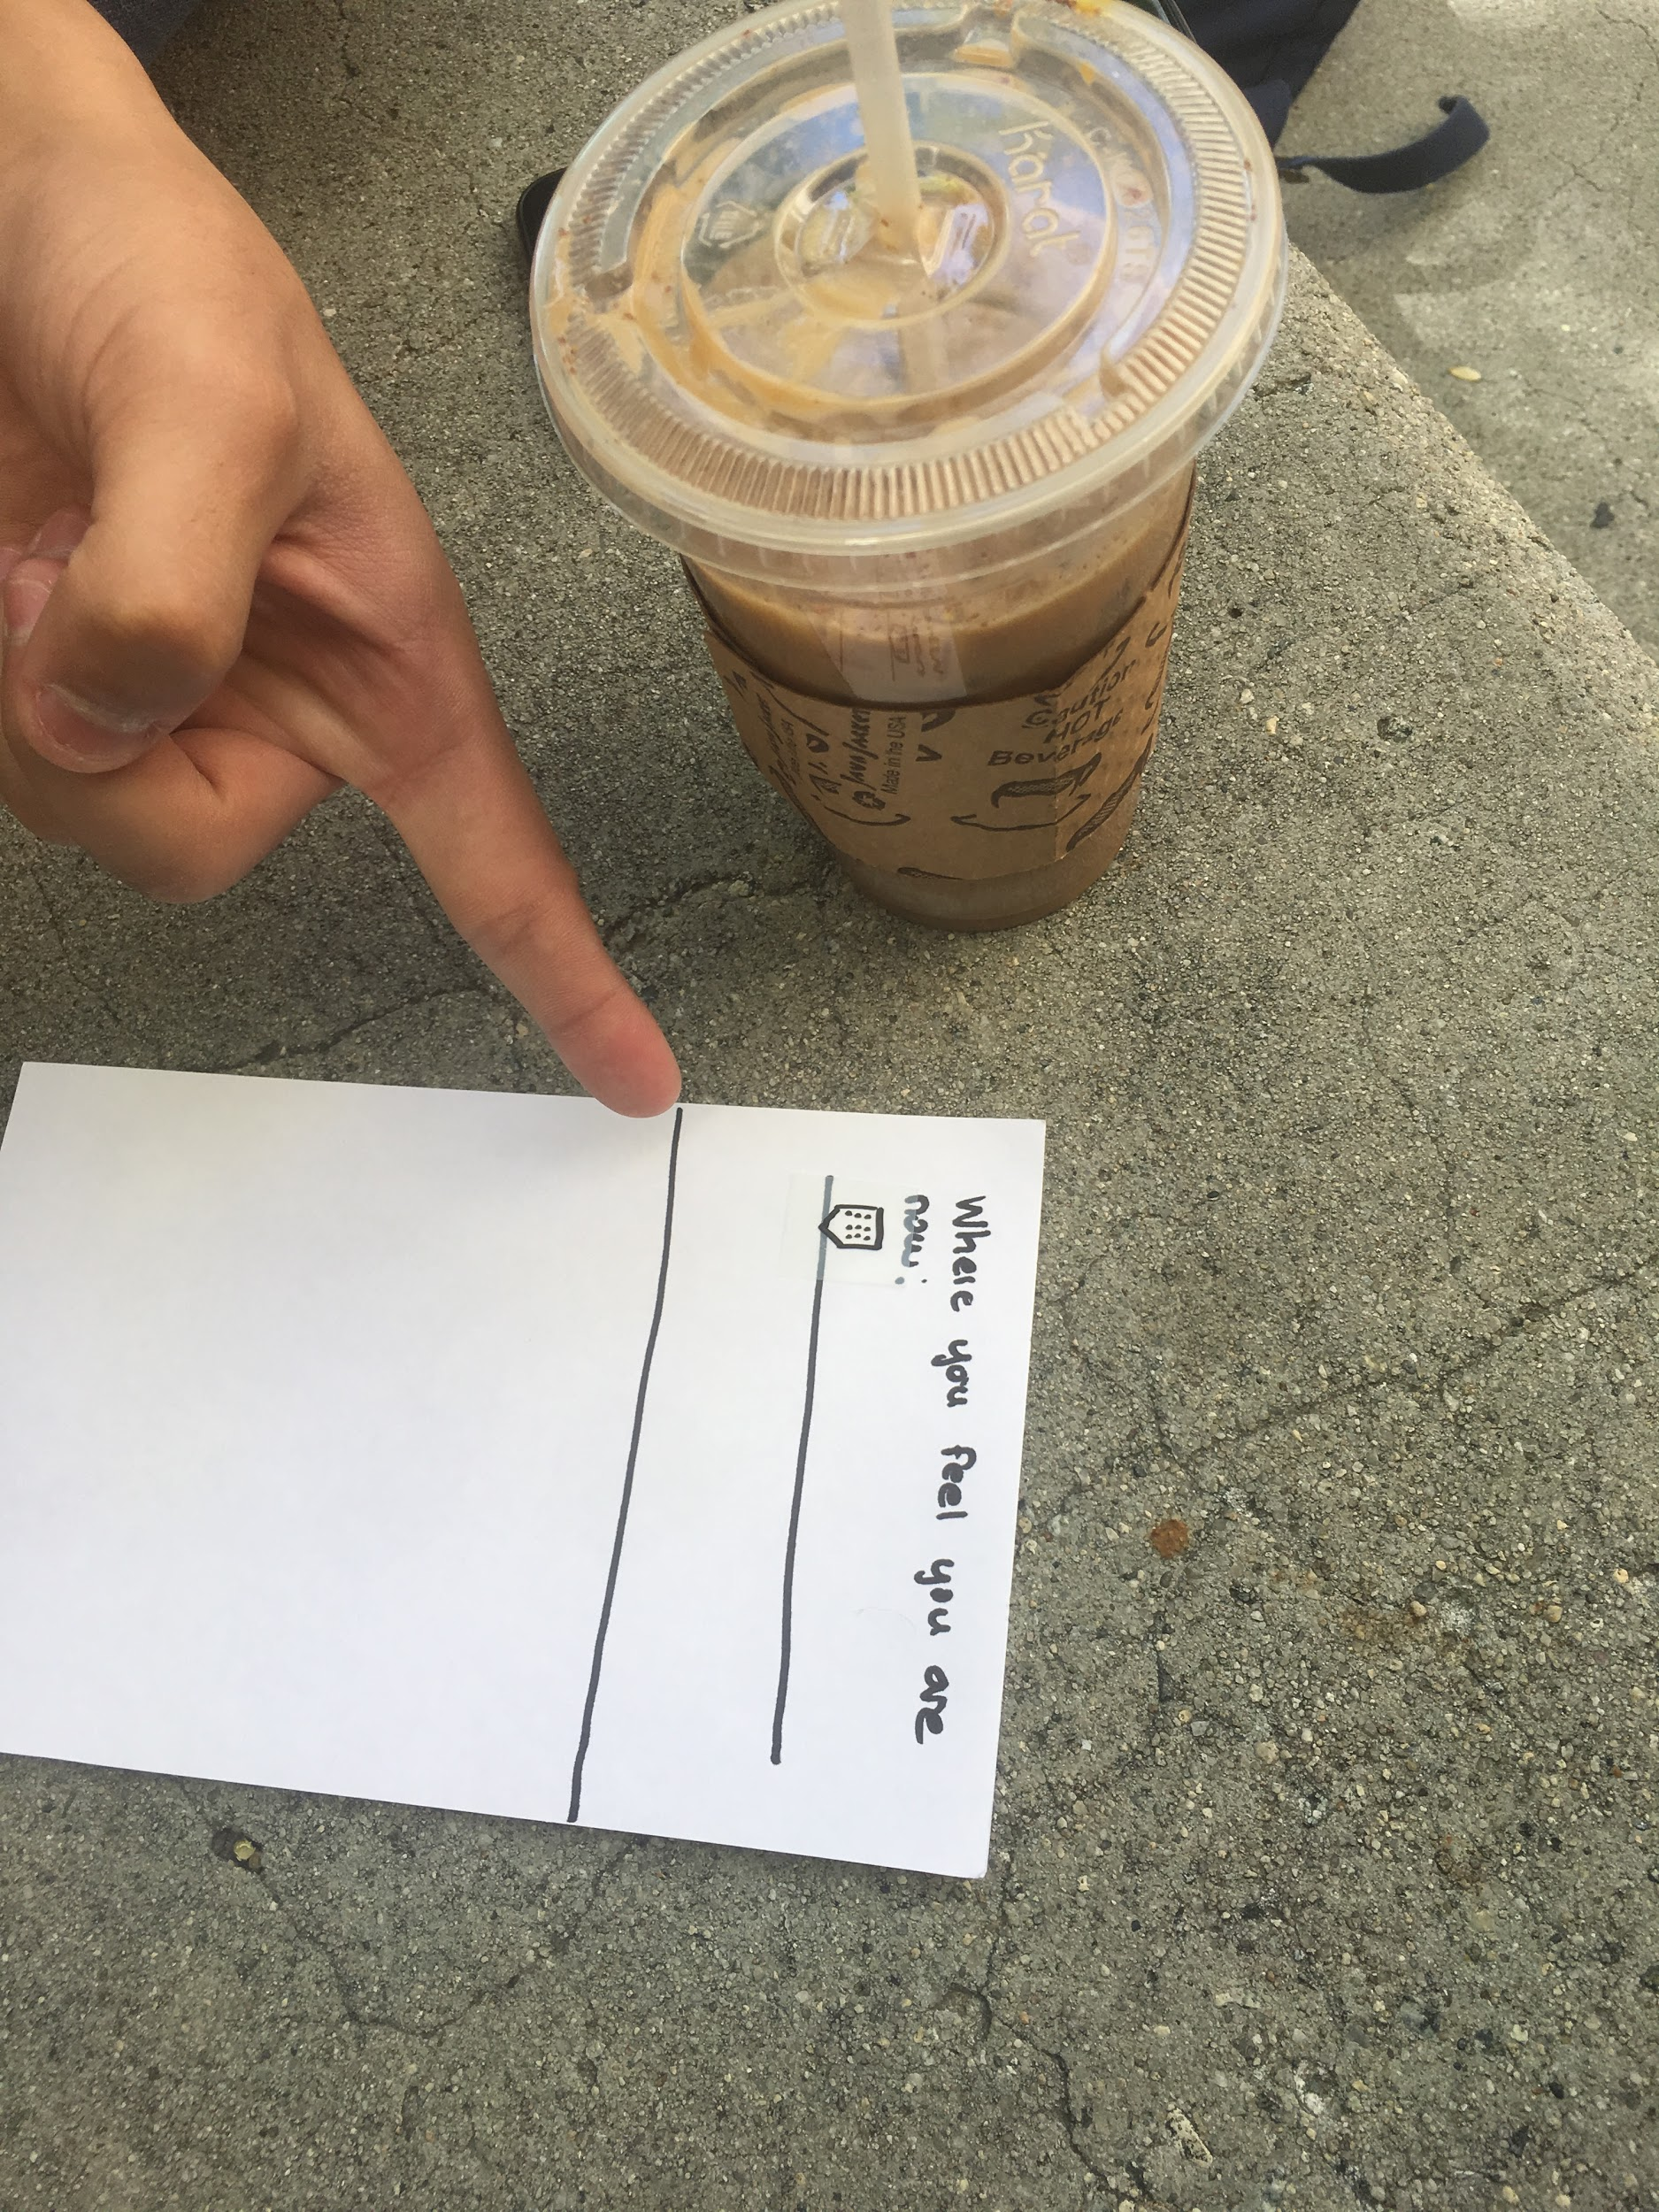
Experience Prototype #3: Slider
Method:
Results:
5 participants
Assumption was valid: validation of political engagements resulted in a higher scoring.
Hidden assumption: people feel guilty about their existing level of political engagement
Extreme user: rated engagement as 0 but was content with that level; didn’t change his scoring after the experience

Slide 28

“When I listed my engagements, even if it wasn’t influential...I feel more active.”

Slide 29
Most Successful Prototype(s) & Next Steps
Slider Prototype
Positive feedback
Assumption correct
Easy to understand for users
Is alleviating guilt over levels of political engagement a worthwhile goal?
Map Prototype
Assumption wrong
People don’t prefer in-person discussions
What is the point of political discussion? To get to know people? To organize? To build community?
Is connecting online or IRL better?

Slide 30
Any questions?

Slide 31
Appendix: See written report for more pictures!

